Slide 1
UNITY 2D FIGHTING BASE

Slide 2
ÍNDEX
Concept 3
Gameplay ?

Slide 3
CONCEPTO
1.1. General
Title – Unity 2D Fighting Base
Genre – Fighting Game
Player – One / Two Players
Tools:
Unity (ver. 2022.3.34f)
Visual Studio (C#)
Fighter Factory Studio (Sprites)
Resources:
https://www.andersonkenya1.net/files/ (Sprites)
https://mugenfreeforall.com/forum/13-collections/ (Sprites)
https://www.spriters-resource.com (UI)
https://www.models-resource.com (Models)
https://www.sounds-resource.com (Sounds)
1.2. High Concept
Is a 2D fighting game base for unity.
This project works as a starting point for the creation of a 2D fighting game, taking as an example the gameplay of SFII.

Slide 4
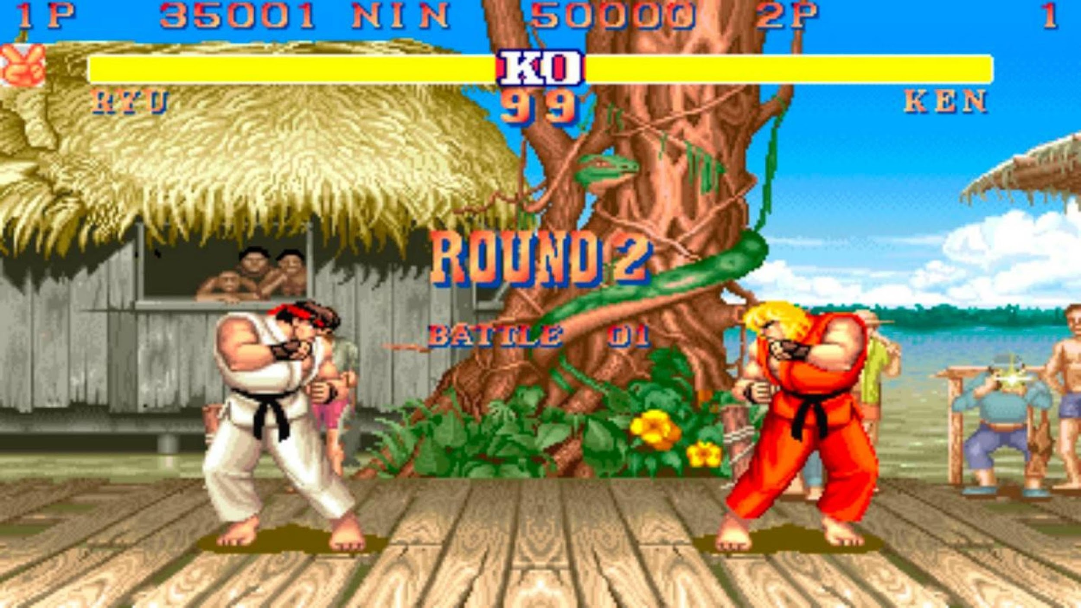
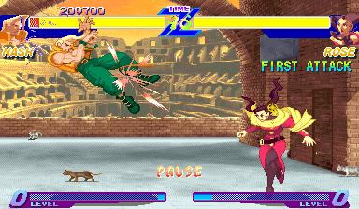
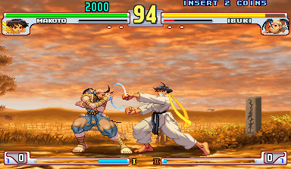
GAMEPLAY
3.1. General
The gameplay takes the core of Street Fighter II and adds some other mechanics that are standard today.
Six Button Attacks 
Command Normal 
Command Inputs 
Special Button Variation
Special Cancel
Super and Meter
Standing and Crouching Block
Stun, Blockstun and Knockback
Throws
Street Fighter II
Alpha Counter
Throw Tech
Quick Stand Tech
Street Fighter Alpha
Dash 
EX Moves
Parry
Target Combos
Street Fighter III

Slide 5
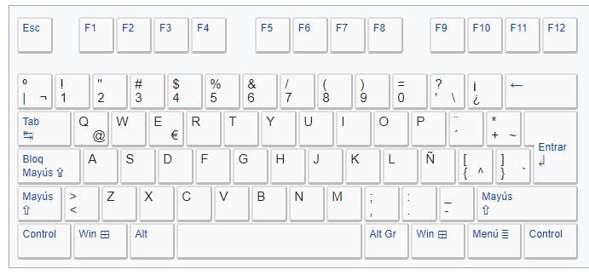
GAMEPLAY
3.2. Controls
Keyboard P1
P1 Movement
P1 Attacks
W - Up
U – Light Punch
A - Left
I – Medium Punch
S - Down
O – Heavy Punch
D - Right
J – Light Kick
K – Medium Kick
L – Heavy Kick
P1 Triggers
Y – Block

Slide 6



GAMEPLAY
3.3. Actions
Basic Movement
Horizontal Movement
Neutral Jump
/
Crouch
Diagonal Jump
/
/
/
Advance Movement
Forward Dash
Backward Dash

Slide 7






GAMEPLAY
3.3. Actions
Normal Attacks
Light Punch
Medium Punch
Heavy Punch
Light Kick
Medium Kick
Heavy Kick
Jump Attacks
Jump Light Punch
Jump Medium Punch
Jump Heavy Punch
+
+
+
Jump Light Punch
Jump Medium Punch
Jump Heavy Punch
+
+
+
Crouch Attacks
Crouch Light Punch
Crouch Medium Punch
Crouch Heavy Punch
+
+
+
Crouch Light Punch
Crouch Medium Punch
Crouch Heavy Punch
+
+
+

Slide 8
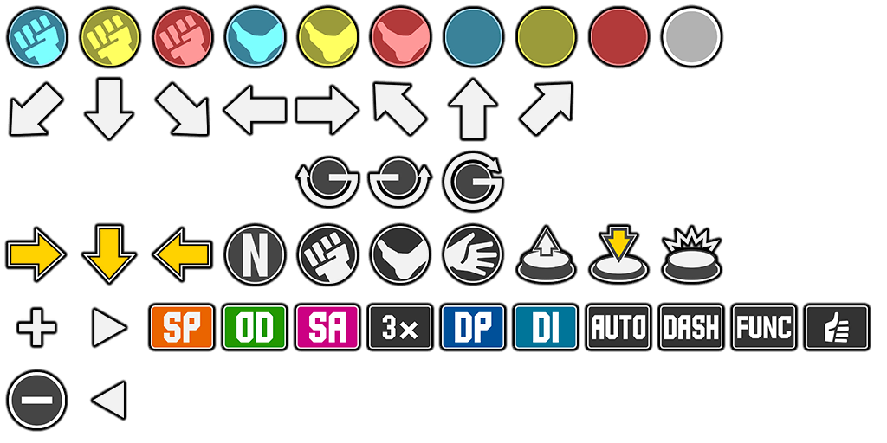
GAMEPLAY
3.3. Actions
Commands Inputs
Commands
/
/
/
+
/
/
/
Command Normal
Back Light Kick
Diagonal Back Medium Punch
Forward Heavy Punch
+
+
+
Special Input
Motion Input
Charge Input
+
+

Slide 9
GAMEPLAY
3.3. Actions
Block
Standing Block
Crouch block
+

Slide 10
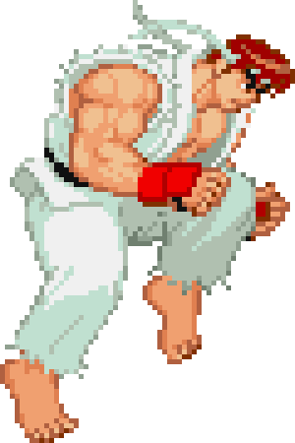
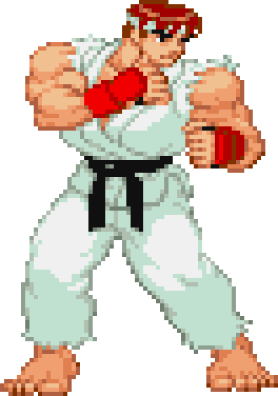
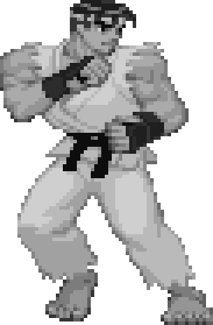
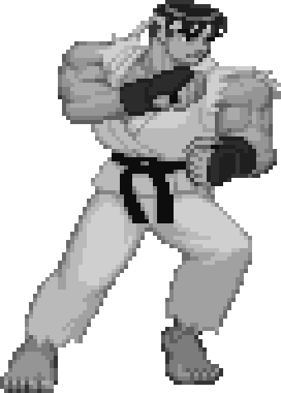
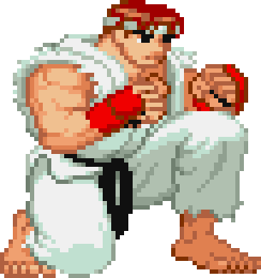
GAMEPLAY
3.4. Basic Movement
Stage States: Characters have two stage states, Grounded and Airborne, depending on whether they are on the surface or not.
Grounded
Airborne
Neutral: When Grounded, the characters are always facing the opponent and automatically turn in their direction.
Horizontal Movement: Characters can move forward and backwards. The velocity changes depending on the direction.
Grounded
Crouch: Characters can crouch in the ground, stops his movement, reduces the hitbox and gives him access to other moves.
Grounded

Slide 11





GAMEPLAY
3.6. Attacks
Every character has a base moveset of six buttons, divided by three standards.
Type of Attack: The part of the body the character is using.
Punch Attack
Kick Attack
Wight of the Attack: Determines the speed and the overall damage of the attack.
Light Attack
Medium Attack
Heavy Attack
State: Depending on the state of the character, they have access to different sets of moves. There are six crouched, normal, and jumping attacks.
Crouch Attack
Standing Attack
Jump Attack

Slide 12





GAMEPLAY
3.6. Attacks
Command Normal: Extra moves that a character can perform by combining an attack button and a direction. The number of extra attacks depends on each character.
Ryu Forward Heavy Punch
+
Special Inputs: All characters have at least two special moves, that can be performed by a combination of move inputs and attack buttons. The type of move deepens on the character, and the effect of the attack can vary a lot.
Ryu Special 1
Ryu Special 2
Ryu Special 3
+
+
+
Differences: Both types of attacks are performed by a combination of inputs. The difference is that we can perform Command Normal as long as the correct combination is pressed, while Special Inputs have to be performed in a certain time and rhythm.

Slide 13




GAMEPLAY
3.6. Defense
Blocking: Characters block when they press the block button, .
This is a Mortal Kombat mechanic, in SF you hold back to block, in this case, we do it this way to not interfere with the direction inputs.
There are two types of blocks, each one covering two types of attacks. Each attack depending on where it hits has a designated height, low, mid, and high.
Standing Blocking: This is executed by pressing the block button, it blocks high and mid attacks, but not low ones.
Standing Block
Crouching Blocking: This is executed by pressing the block button and the down input, it blocks mid and low attacks, but not high ones.
Crouched Block

